Slide 1



by
Transforming Business Processes

Slide 2

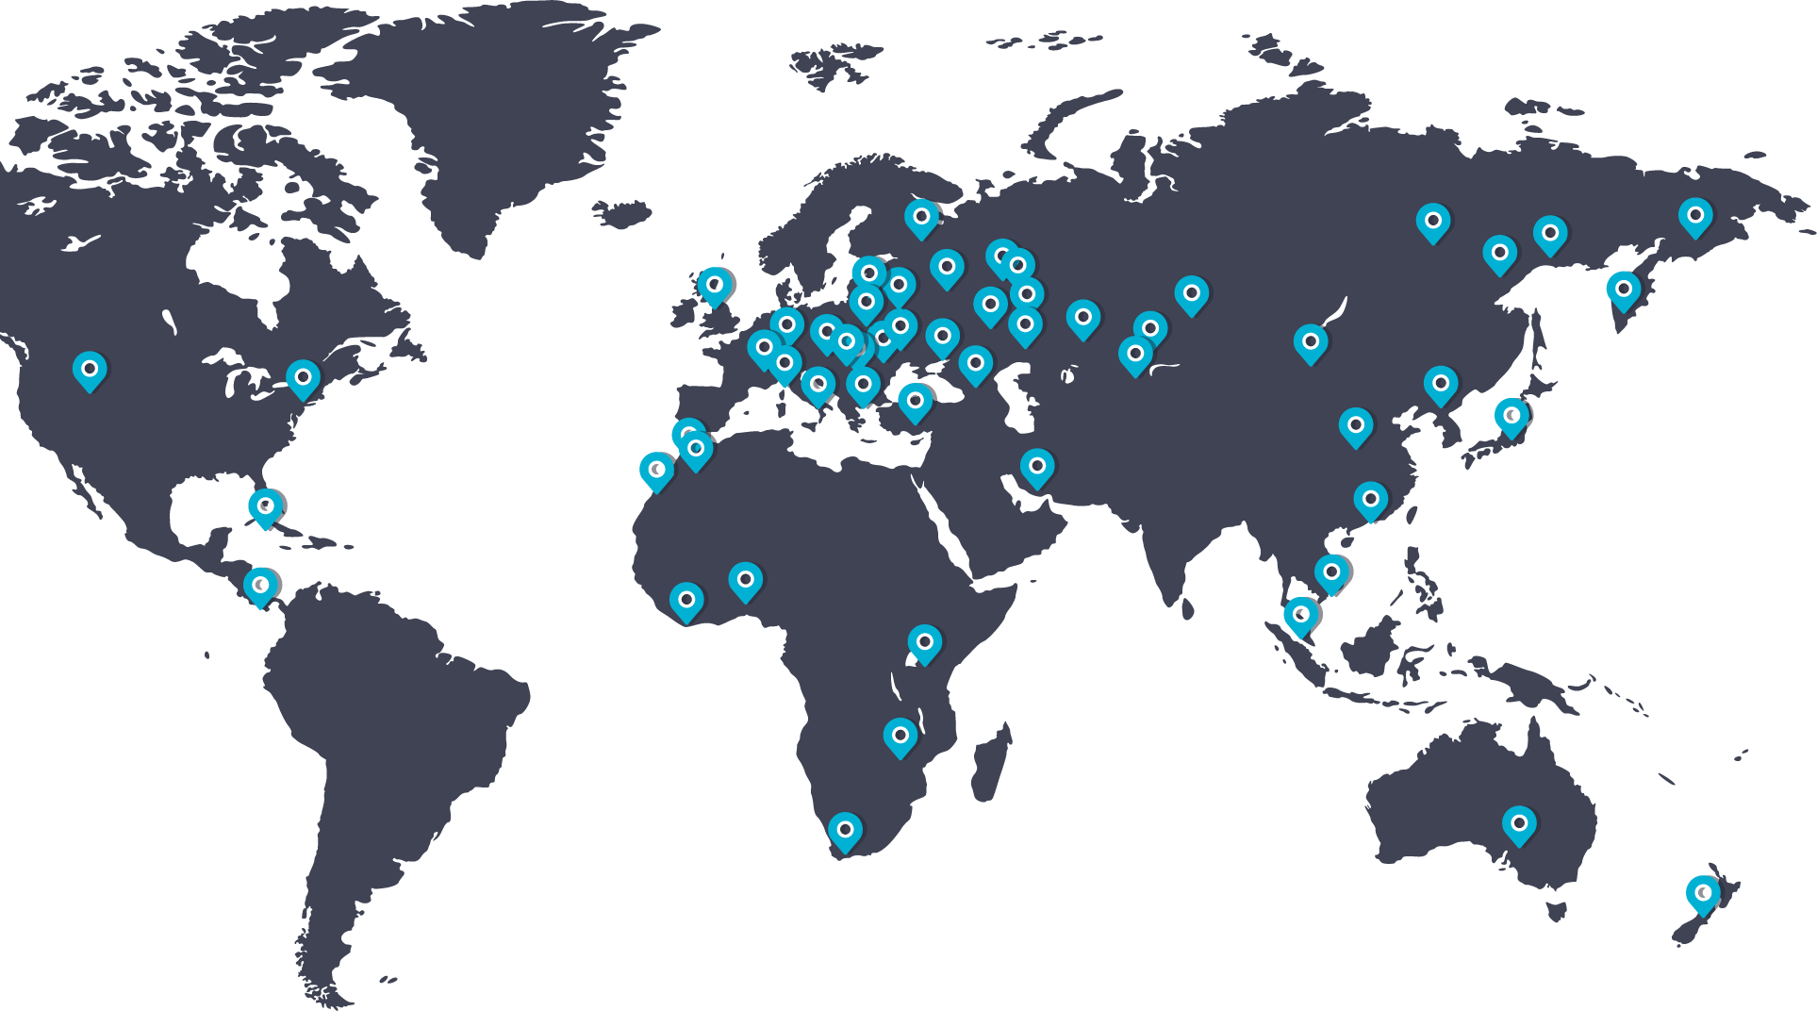




Transforming Business Processes
HAULMONT TECHNOLOGY
Intelligent process automation and document management platform
Automated taxi dispatch solution
Rapid Application Development framework for enterprise software development
8
400+
2008
International implementations
offices
specialists
foundation year

Slide 3
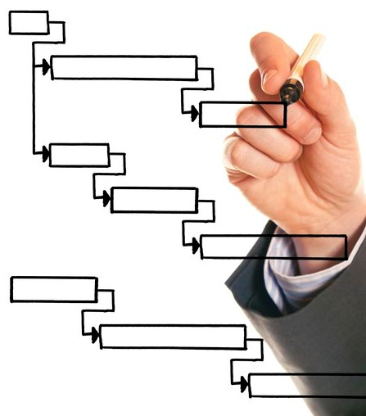
Transforming Business Processes
THESIS: STRUCTURING THE UNSTRUCTURED
A platform to accelerate business processes
Create automated workflows to expedite processes and reduce admin time
Digitise physical documents reducing paper and man-hours spent indexing
A central repository of data to facilitate simple document access
Multi-channel notifications including e-mail, mobile and in-app
Powerful reporting tools to provide management information and quickly identify bottlenecks

Slide 4
Transforming Business Processes
WHY THESIS?
Varied customers
Broad solutions
Reduce time spent on repetitive tasks using process automation tools
Realise efficiency savings of up to 80% in the organisation
1
4
Provide a central store of critical business information for rapid retrieval
2
5
Boost productivity amongst staff
Automate the creation and approval of business information
3
6
Reduce costs and increase profitability

Slide 5








Transforming Business Processes
A CUTTING EDGE PLATFORM
Cloud or on-premise based platform ready to use immediately
Mobile app support including native iOS and Android
Supports all common platforms and devices
Open code which is fully customisable
Support for language localisation
Dedicated team of approx. 100 staff working on THESIS platform
Over 400 clients using THESIS across 37 countries
Working with select partners with specific areas of expertise

Slide 6

Transforming Business Processes
FROM A TRUSTED TECHNOLOGY PARTNER
Varied customers
Broad solutions
Expertise from an experienced content services team
Named project manager for professional implementations
Technical support via Skype, email or helpdesk portal
Access ongoing training, support and best practice guides
Input into future product features and releases

Slide 7














Transforming Business Processes
WITH AN INTERNATIONAL CUSTOMER BASE INCLUDING…
Varied customers
Broad solutions

Slide 8
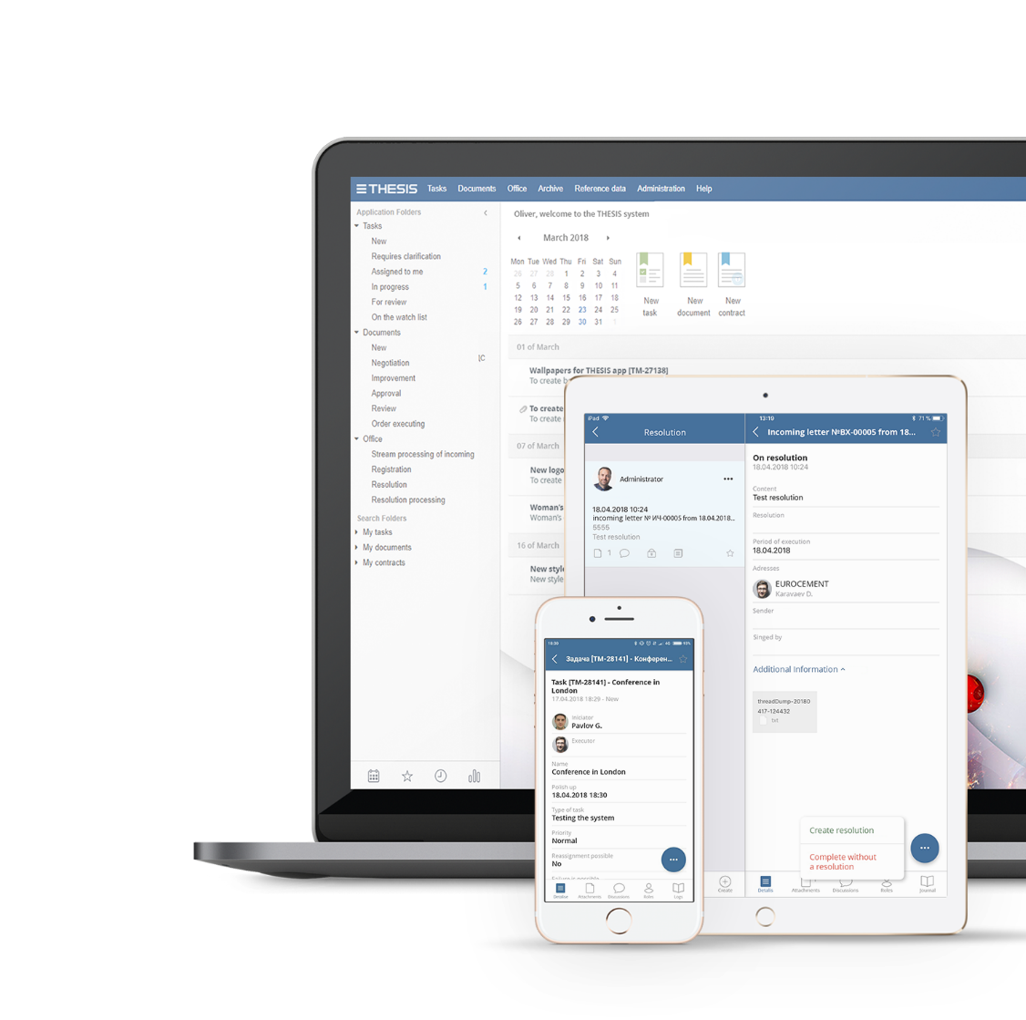
Transforming Business Processes
AND IMPLEMENTATION OPTIONS TO SUIT
Standard
Project Managed
1
THESIS activation
1
Process audit
2
User & administrator training
2
Functional specification
3
Support during configuration
3
System build
4
Go-live
4
Data migration
5
Installation
6
Training & UAT
7
Roll out and go-live

Slide 9


Transforming Business Processes
CASE STUDY: RUSSIAN MARITIME REGISTER OF SHIPPING
Varied customers
Broad solutions
Situation
One of the world’s largest shipping registers
160,000 documents per annum and 5000 vessels in fleet
HQ with no view of activity across 146 offices globally
Solutions & outcomes
Easily accessible central repository of information
Automated business processes saving 80% admin time to process ship inspections
Organisation has saved the equivalent of £1 million per annum in staff costs

Slide 10


Transforming Business Processes
CASE STUDY: ALLIANCE OIL COMPANY
Varied customers
Broad solutions
Situation
Six disparate data warehouses across multiple locations
Geographically sparse spanning eight time zones
Solutions & outcomes
Easily accessible central repository of information
Centrally managed business processes
Accuracy of financial planning increased to 97%
400% increase in financial planning efficiency
Time taken to reconcile payment registers reduced by 33%
Organisation has saved the equivalent of over £2 million per annum

Slide 11


Transforming Business Processes
CASE STUDY: TAB BANK
Varied customers
Broad solutions
Situation
Disparate file systems in place across multiple locations
Paper-based manual processes
Solutions & outcomes
Easily accessible central repository of information
Automated workflows to manage dispute tracking
“The biggest benefit has been in reducing touch points where there is potential for human error”
Tracking tasks and follow-ups saving 12 hours per week in admin time

Slide 12
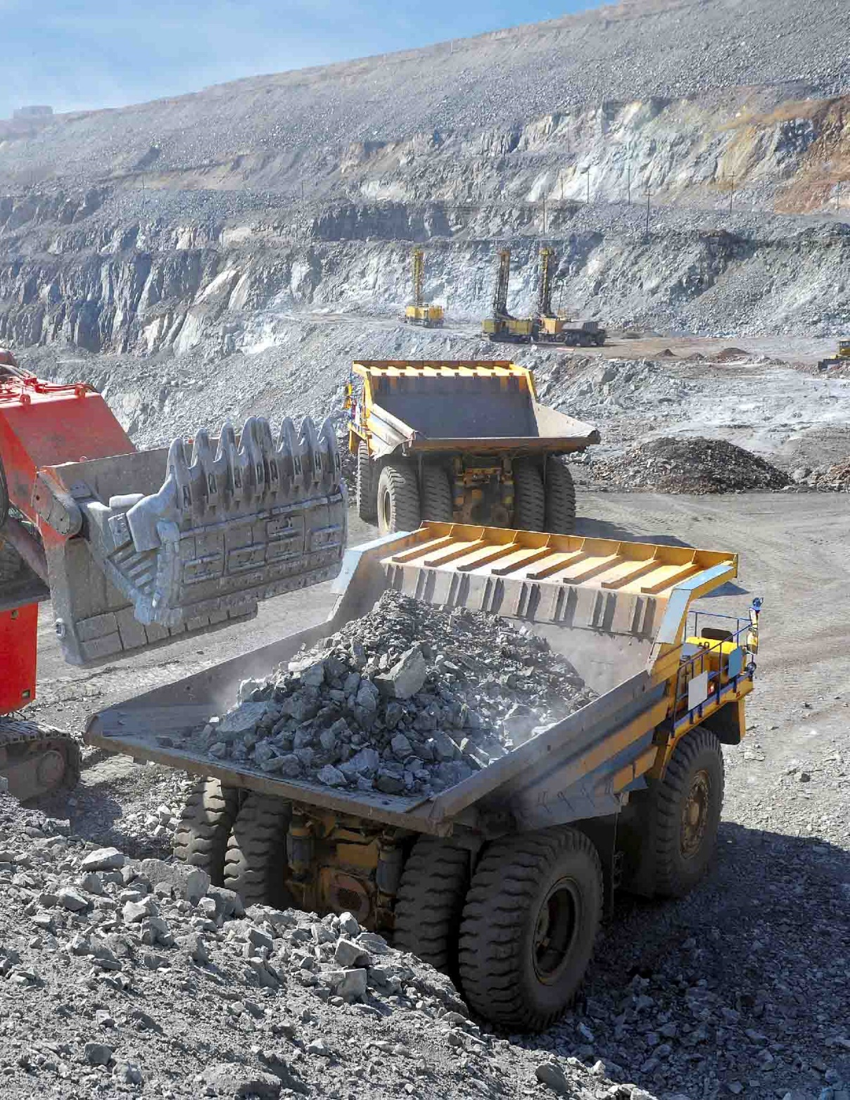

Transforming Business Processes
CASE STUDY: RUSSIAN PLATINUM
Varied customers
Broad solutions
Situation
Offices spread across locations with up to seven hours time difference creating a lag in collaboration between different departments
Solutions & outcomes
Implemented an end-to-end process in which documents could be tracked easily across multiple offices and geographical locations
Central document repository with different access rights for different users
Transparency across the business increased significantly
50% reduction in time taken to reconcile contracts between parent company and subsidiaries

Slide 13


Transforming Business Processes
CASE STUDY: ROSGEO
Varied customers
Broad solutions
Situation
Geographically sparse spanning seven time zones
Lag in correspondence; difficulty sharing documents easily across multiple locations
Solutions & outcomes
Automated reports saving admin time and manual effort
Increased visibility of critical documents across the organisation
Easy adoption throughout the organisation with 800 tasks and 1700 documents registered in one month

Slide 14


Transforming Business Processes
CASE STUDY: INGOSSTRAKH
Situation
Offices spread across locations with up to seven hours time difference creating a lag
Solutions & outcomes
Ingosstrakh needed a solution which could process up to 1500 documents a day and automate repetitive tasks for 6000 employees
Implemented specific workflows to track all legal documents coming into the organisation
Time taken to share information and collaborate across the business significantly reduced
Insurance

Slide 15


Transforming Business Processes
Contact
Sid Shepherd
Business Development Manager
THESIS UK & Ireland
T: +44 (0)2039 928 357
E: sid@haulmont.com
Haulmont Technology
286 Euston Road, LONDON, NW1 3DP
www.thesis-ecm.com
Nick Fernandes
Business Development Manager
THESIS UK & Ireland
T: +44 (0)2039 928 358
E: nick@haulmont.com
Haulmont Technology
286 Euston Road, LONDON, NW1 3DP
www.thesis-ecm.com

